Slide 1
Self-Organizing List
In-class implementations, extensions, and further application

Slide 2
Methods of self-organizing
Based on access
Aims to reduce the access time by moving ‘more-frequently-accessed’ items closer to the O(1) access index (typically at index=0)
Move-up-one
Move-to-front
Move-up-half
Move-random

Slide 3

Move-to-front (MTF)
A
B
C
D
E
F
G
H
1) Initialize list
I want E
3) Grant information
2) Identify access
4) Move to front
E
A
B
C
D
F
G
H
E
A
B
C
D
F
G
H

Slide 4
Move-up-one (MUO)
A
B
C
D
E
F
G
H
1) Initialize list
I want E
3) Grant information
2) Identify access
4) Move closer to index = 0
E
A
B
C
D
F
G
H
E
A
B
C
D
F
G
H

Slide 5
Comparison so far
A
B
C
D
E
F
G
H
E
A
B
C
D
F
G
H
Move-to-front (MTF)
A
B
C
E
D
F
G
H
Move-up-one (MUO)

Slide 6
Methods of self-organizing
Based on access
Aims to reduce the access time by moving ‘more-frequently-accessed’ items closer to the O(1) access index (typically at index=0)
Move-up-one
Move-to-front
Move-up-half
Move-random

Slide 7
Move-up-half (MTF)
0
1
2
3
4
5
6
7
A
B
C
D
E
F
G
H
1) Initialize list
I want H
3a) Grant information
3b) Identify position of information (index = 7)
4) Calculate half:
half_index = index//2
# 7//2 = 3
2) Identify access
0
1
2
3
4
5
6
7
H
A
B
C
D
E
F
G
E
A
B
C
D
F
G
H

Slide 8
Move-up-random (MUR)
0
1
2
3
4
5
6
7
A
B
C
D
E
F
G
H
1) Initialize list
I want H
3a) Grant information
3b) Identify position of information (index = 7)
4) Calculate random number across [0, index):
random_index = random.randInt(0, index)
# let’s say, 5
2) Identify access
0
1
2
3
4
5
6
7
H
A
B
C
D
E
F
G
E
A
B
C
D
F
G
H

Slide 9
Further comparisons
A
B
C
D
E
F
G
H
A
B
C
H
D
E
F
G
Move-to-half (MUH)
(index = 7 → index = 3)
A
B
C
D
E
H
F
G
Move-up-random (MUR)
(index = 7 → index = 5)

Slide 10
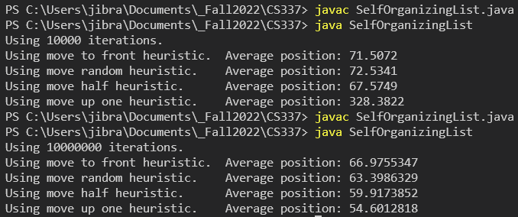
Method
Initialize in order array with elements [0, N) (N=1000)
Generate random number [0, N) via gaussian distribution
Use current heuristic to manipulate array accordingly
Results
Notes:
Move-to-front and Move random perform similarly at less iterations
Move half is marginally best case at less iterations
Move-up-one becomes more effective at larger iterations
Average position indicates the average index at which the requested value was found after M iterations

Slide 11
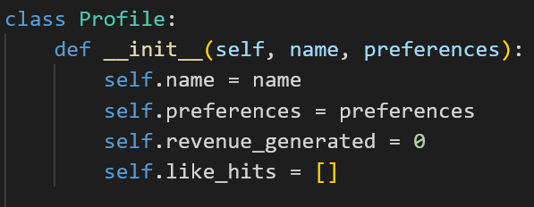
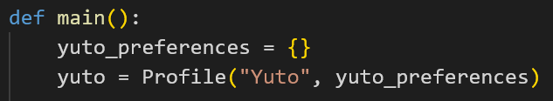
Application (E-commerce simulation)

Slide 12
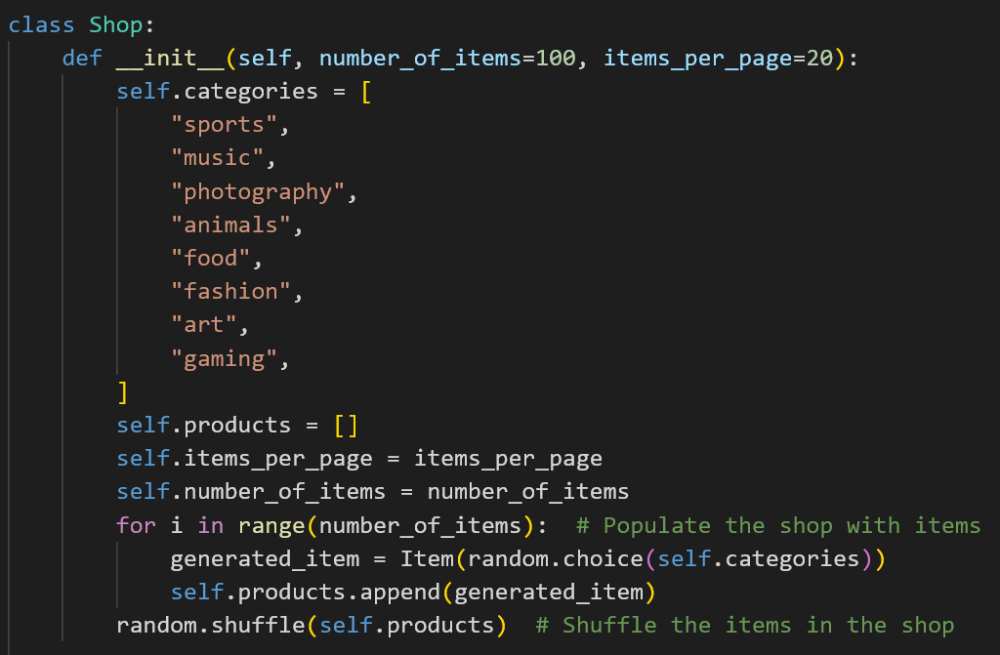

Slide 13
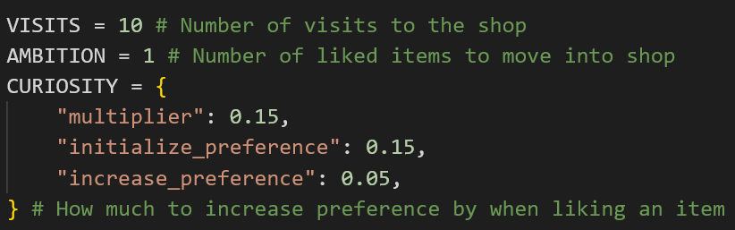

Slide 14
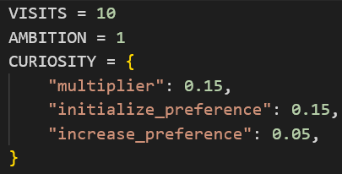
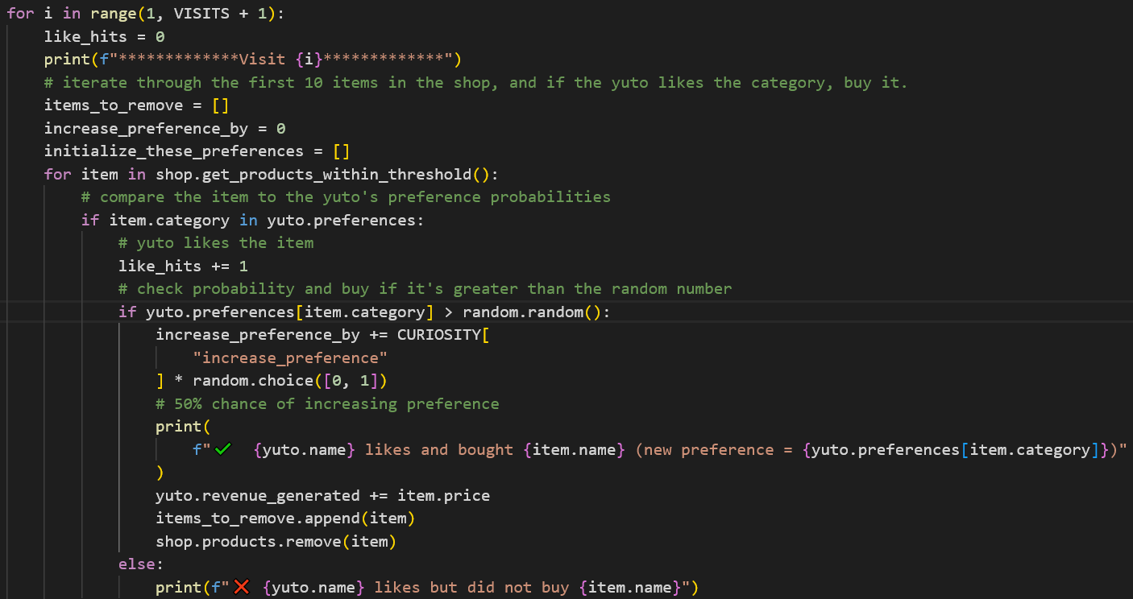
items_to_remove

Slide 15
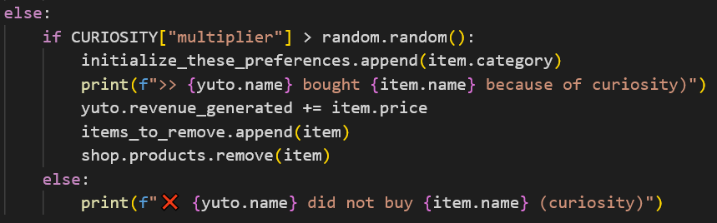
items_to_remove
initialize_these_preferences

Slide 16
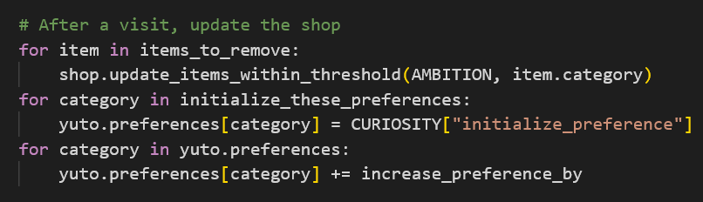
items_to_remove
initialize_these_preferences
*Note: the shop and preferences are updated after each visit

Slide 17
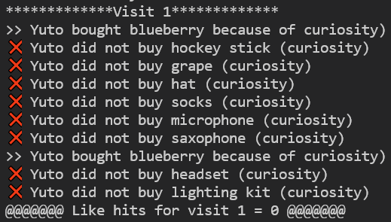
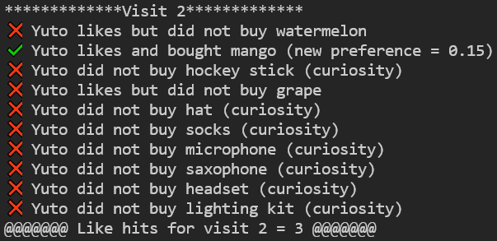
curiosity
preferences updated to match curiosity

Slide 18
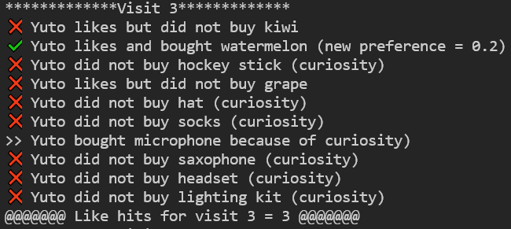
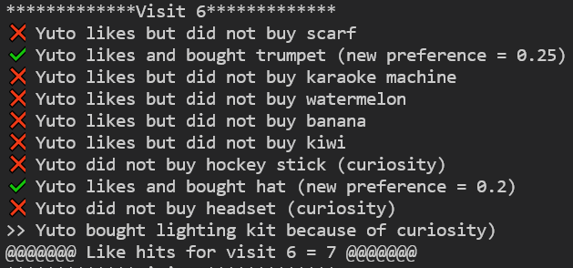
buying choice despite preference met
increasing “like hits” each visit

Slide 19
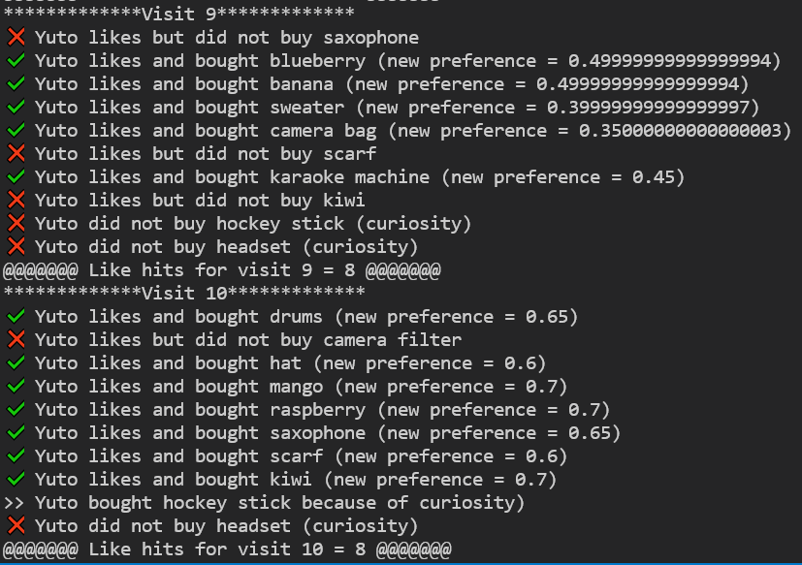

Slide 20
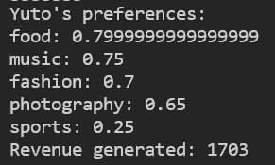
Findings
(with empty preferences) Customer seemingly gains preferences
Like hits for this implementation relies on showing user what they have already shown interest in, but also things from other categories
Ways to expand:
more categories
normalize item cost across each category to use revenue as a measurable metric

